Slide 1
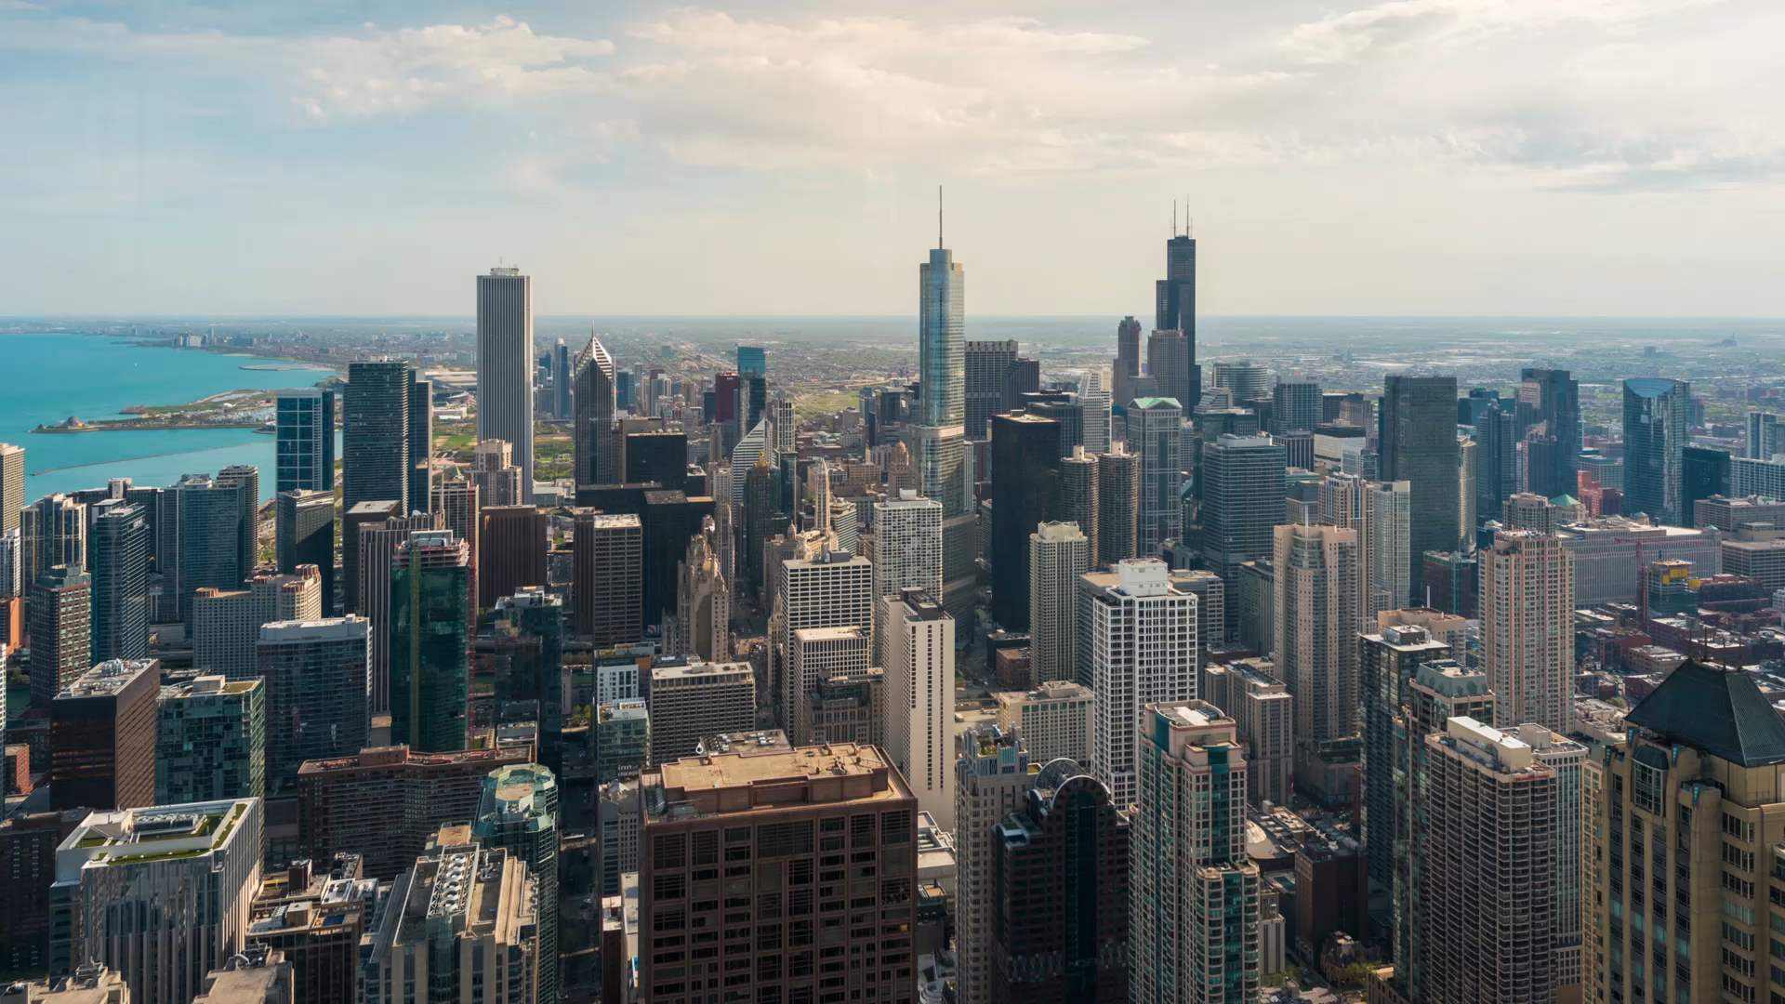
RESTAURANT DATA ANALYSIS
Presentation by:
GROUP-14

Slide 2
MARKET POTENTIAL
COUNTRY | NO. OF RESTAURANTS
India | 8652
United States | 434
United Kingdom | 80
Brazil | 60
UAE | 60
South Africa | 60
New Zealand | 40
Turkey | 34
Australia | 24
Philippines | 22
Indonesia | 21
Sri Lanka | 20
Singapore | 20
Qatar | 20
Canada | 4
BEST COUNTRY FOR BUSINESS LAUNCH ?
RECOMMENDATION:
India has a strong demand for restaurants.

Slide 3
ESTABLISHING CITY
# Find the city with the highest number of restaurants
most_restaurants_city = final_df[final_df['Country'] == 'India']['City'].value_counts().idxmax()
# Filter the DataFrame for the chosen city
city_df = final_df[final_df['City'] == most_restaurants_city]
print(f"Highest Number of Restaurants are located in {most_restaurants_city}: {len(city_df)}")
# Print the Count of Restaurants as per locality in the chosen city
locality_counts = final_df['Locality'].value_counts()
print(f"\nNumber of Restaurants in" ,most_restaurants_city ,"Locality:")
print(locality_counts)
OUTPUT:
Highest Number of Restaurants are in New Delhi: 5473
Number of Restaurants in New Delhi Locality:
Connaught Place --122
Rajouri Garden --99
Shahdara --87
Defense Colony-- 86
Pitampura-- 85
IDEAL CITY FOR RESTAURANT LAUNCH ?
RECOMMENDATION:
New Delhi identified as Prime city.

Slide 4
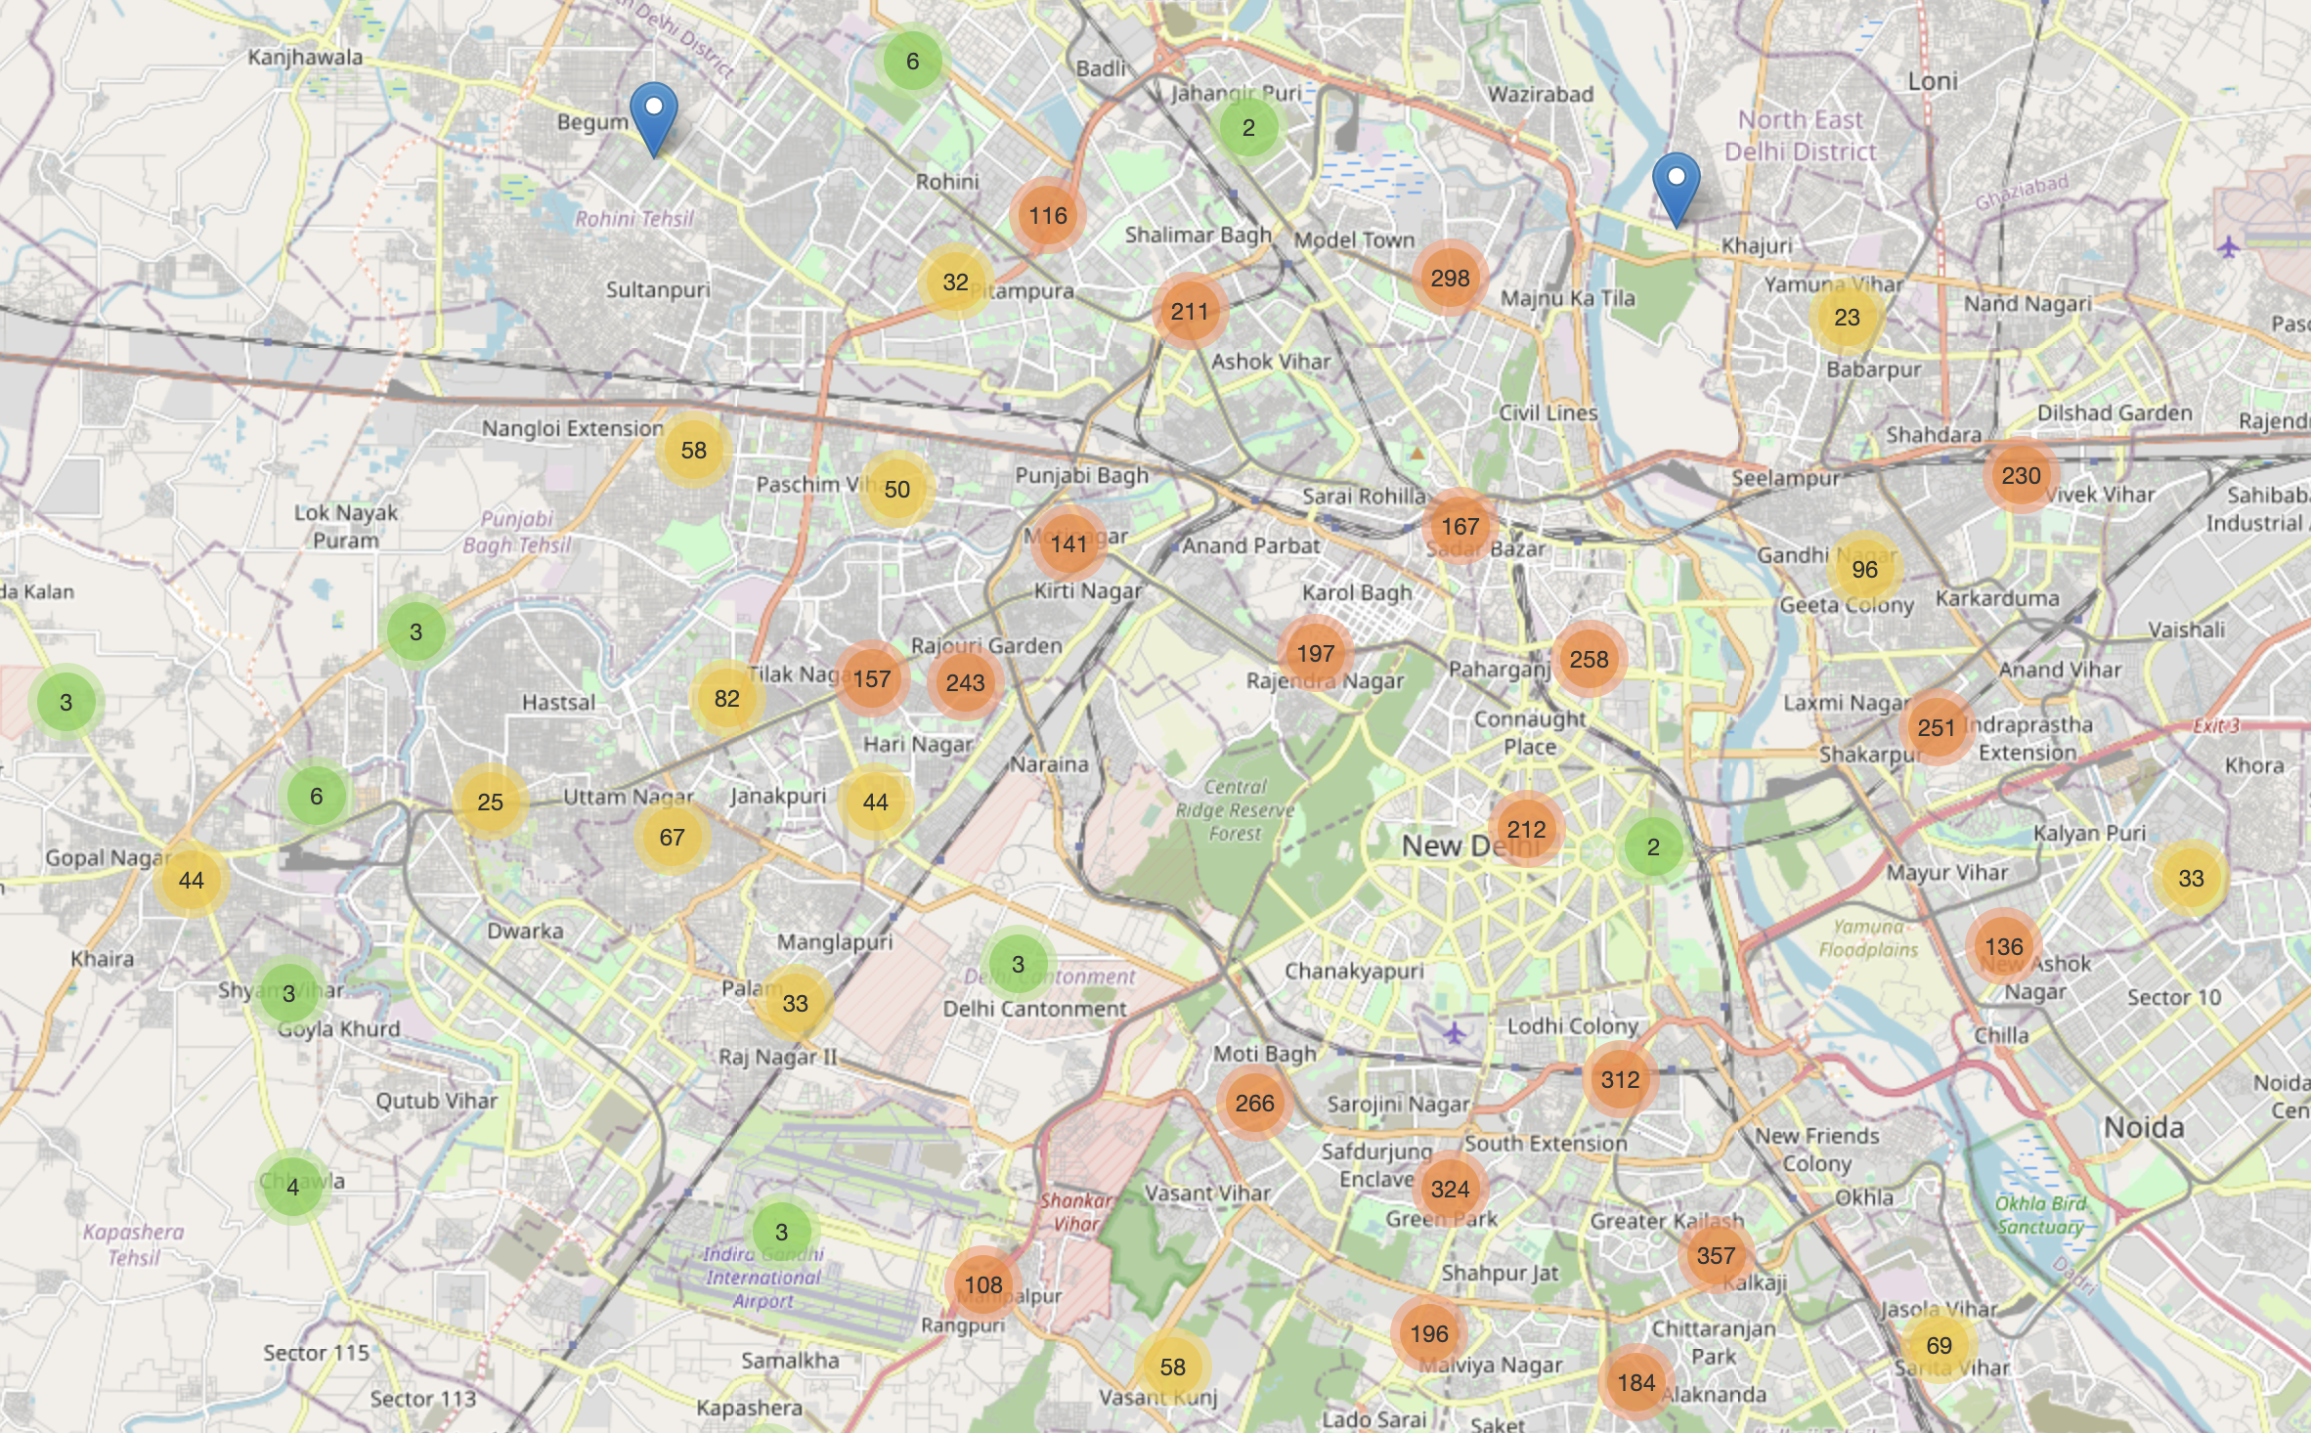
RESTAURANT DENSITY
DENSITY OF RESTAURANTS ?
RECOMMENDATION:
Start a restaurant in the North-East region, where restaurant numbers are less, offers reduced competition.

Slide 5
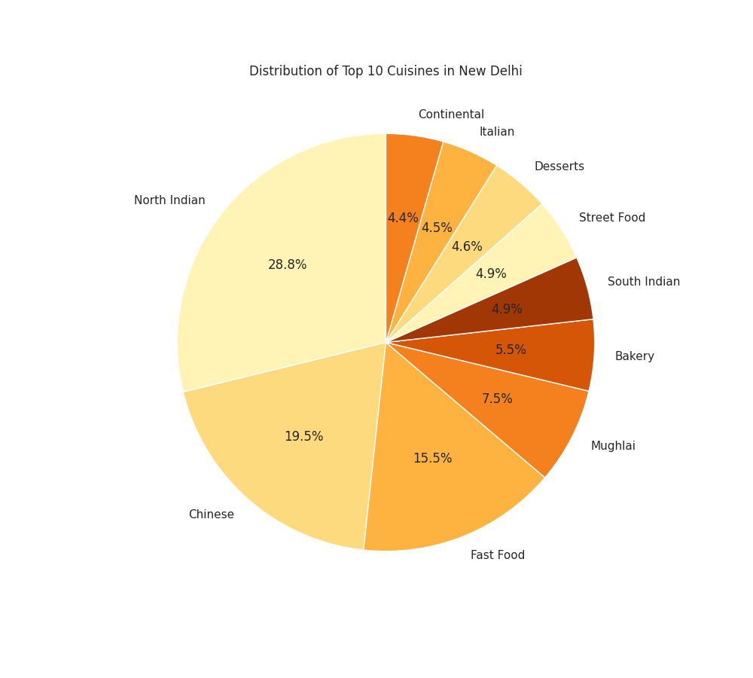
CULINARY PREFERENCES
RECOMMENDATION:
Focus on serving a Fusion Cuisine (Indian-Chinese fusion cuisine).
TOP CUISINES PREFERRED ?

Slide 6
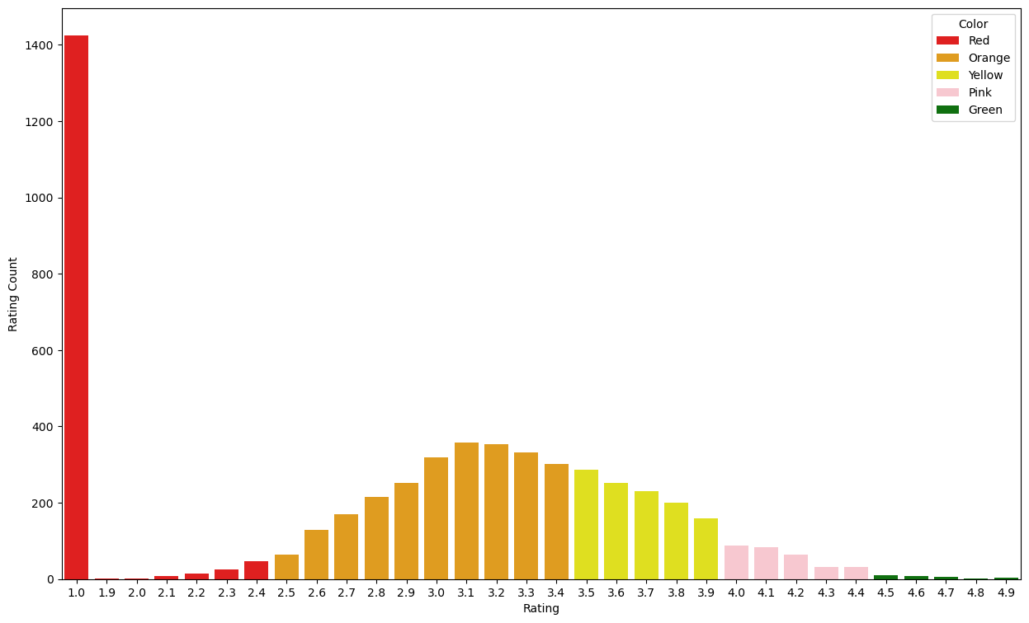
QUALITY MATTERS
RECOMMENDATION:
Few restaurants with ratings above 4 exist.
Sustainable in market through excellent food quality.
INSIGHTS ON RATING DISTRIBUTION ?

Slide 7
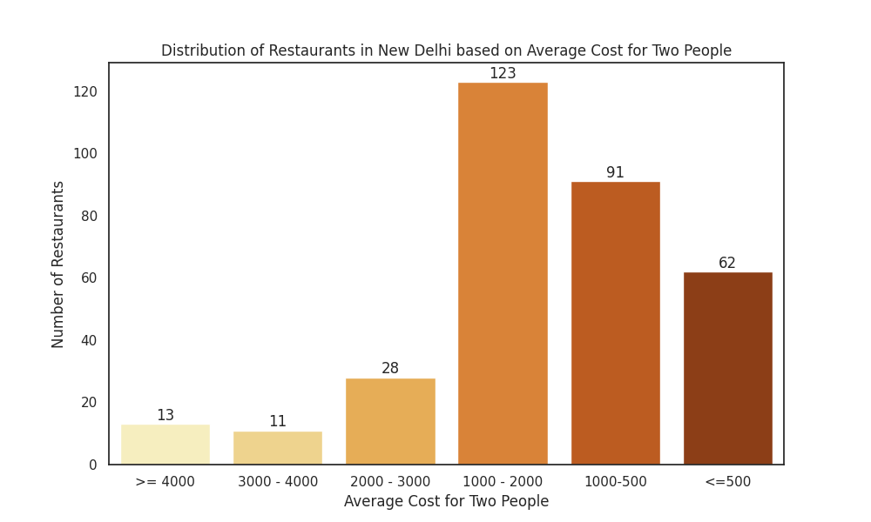
AFFORDABILTY
RECOMMENDATION:
Target the mid-priced range, where the average cost for two people is between ₹1000 and ₹2000.
AVERAGE COST FOR TWO WITH RATING ABOVE 4 ?

Slide 8
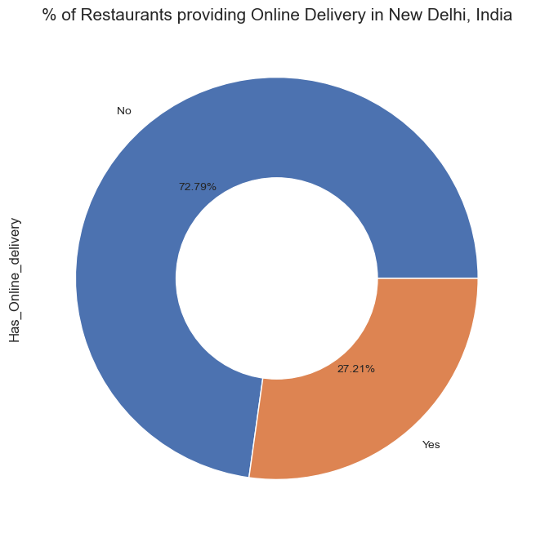
SERVICE OFFERING
RECOMMENDATION:
Tap into the expanding online delivery market by teaming up with food platforms, ensuring competitive prices.
PROPORTION OF RESTAURANTS OFFERING ONLINE FOOD DELIVERY SERVICES ?

Slide 9
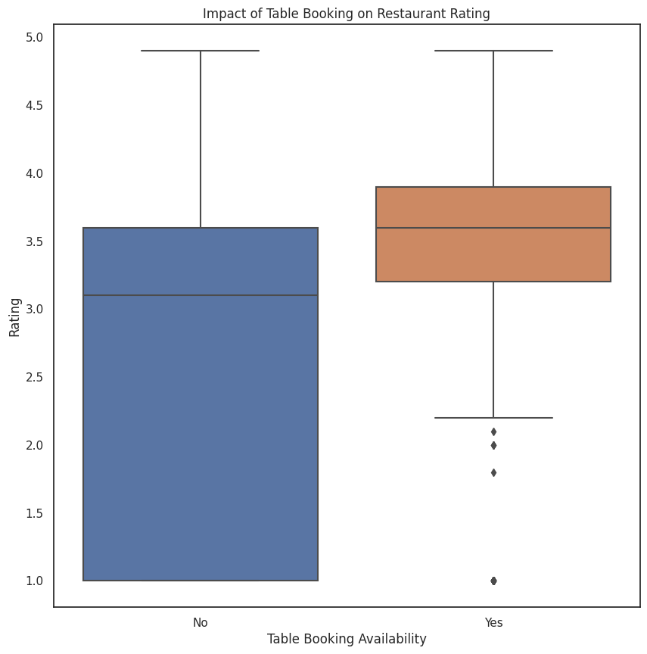
CUSTOMER SATISFACTION
RECOMMENDATION:
Restaurants offering table booking (average rating: 3.482) outperform those without (average rating: 2.809), indicating customer preference for reservation options, crucial in bustling cities like New Delhi.
RESTAURANT’S RATING CORRELATION WITH ONLINE ORDERS AND TABLE BOOKING SERVICES ?

Slide 10
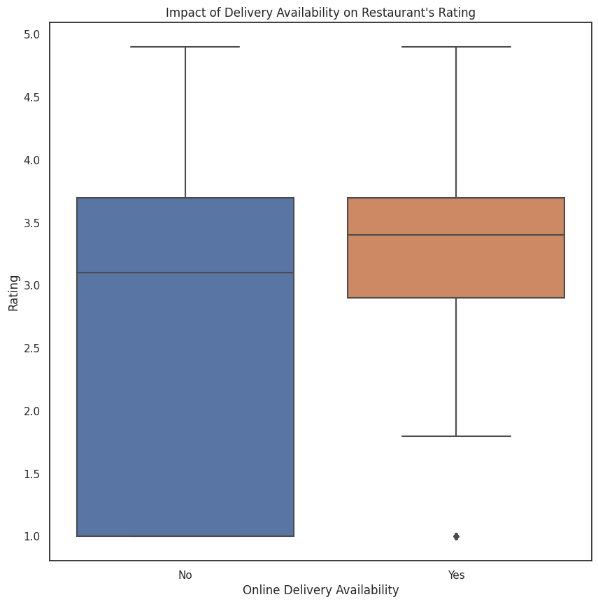
CUSTOMER SATISFACTION
RECOMMENDATION:
Restaurants offering Online delivery, with a mean rating of 3.288, outperform those without (mean rating 2.754), emphasizing customer preference for convenience.
RESTAURANT’S RATING CORRELATION WITH ONLINE ORDERS AND TABLE BOOKING SERVICES ?

Slide 11
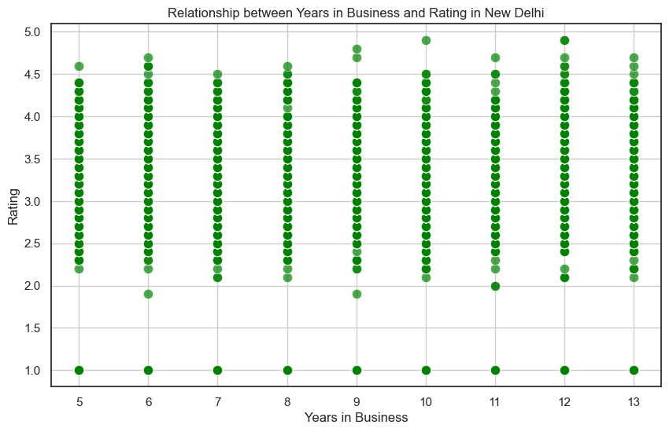
PATH TO SUCCESS
CONCLUSION:
Achieving top ratings (above 4.5) takes five years for restaurants.
INSIGHTS ON RESTAURANT RATINGS OVER TIME ?

Slide 12
THANK YOU

